Slide 1
Storage Area Network
Module 2.2
Notes:
Module 2.2 – Storage Area Network

Slide 2
Module Objectives
Upon completion of this module, you will be able to:
Describe SAN and its benefits
Discuss components of SAN
Describe connectivity options of SAN
Describe FC protocol stack and FC addressing
List common FC topologies
Notes:
The objectives for this module are shown here. Please take a moment to read them.

Slide 3
Lesson - Fibre Channel SAN
Upon completion of this lesson, you will be able to:
Define Storage Area Network and its benefits
Define Fibre Channel
List the component of SAN
Describe three FC interconnectivity options
List different FC port types
Notes:
The objectives for this lesson are shown here. Please take a moment to read them.

Slide 4
Business Needs and Technology Challenges
Just-in-time information to business users
Integration of information infrastructure with business processes
Flexible and resilient storage architecture
DAS is inefficient to meet these challenges
  Storage Networking emerged as a solution
    FC SAN
    NAS
    IP SAN
Notes:
Just-in-time information to business users: Information must be available to business users when they need it. The explosive growth in online storage, proliferation of new servers and applications, spread of mission-critical data throughout enterprises, and demand for 24 × 7 data availability are some of the challenges that need to be addressed.
Integration of information infrastructure with business processes: The storage infrastructure should be integrated with various business processes without compromising its security and integrity.
Flexible and resilient storage architecture: The storage infrastructure must provide flexibility and resilience that aligns with changing business requirements. Storage should scale without compromising performance requirements of the applications and, at the same time, the total cost of managing information must be low.

Slide 5
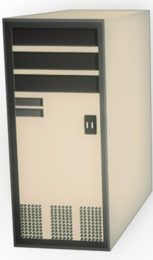
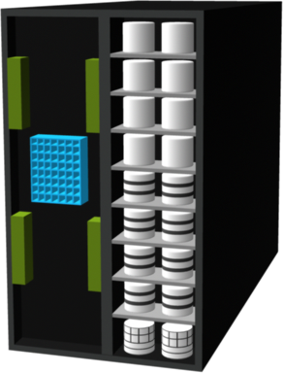
What is a SAN ?
Dedicated high speed network of servers and shared storage devices
Provide block level data access
Resource Consolidation
  Centralized storage and management
Scalability
  Theoretical limit: Appx. 15 million devices
Secure Access
Servers
FC SAN
Storage Array
Storage Array
Notes:
A storage area network (SAN) is a dedicated high speed network for block level data access. It carries data between servers (also known as hosts) and storage devices through Fibre Channel switches. SAN enables storage consolidation and allows storage to be shared across multiple servers. SAN provides the physical communication infrastructure and enables secure and robust communication between host and storage devices.

Slide 6
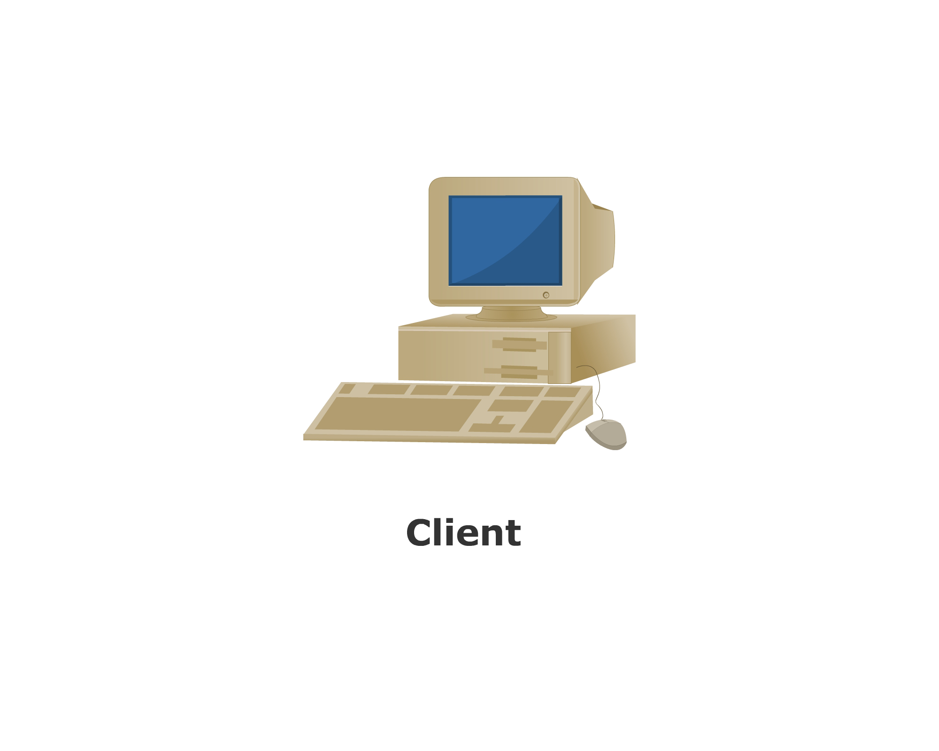
Understanding Fibre Channel
Fibre Channel is a high-speed network technology uses:
  Optical fiber cables (for front end connectivity)
  Serial copper cables (for back end connectivity)
Latest FC implementations support 8Gb/s
Servers are attached to 2 distinct networks
  Back-end
  Front-end
IP
network
FC SAN
Users and
Application
Clients
Servers and
Applications
Storage and
Application
Data
Notes:
The FC architecture forms the fundamental construct of the SAN infrastructure. Fibre Channel is a high-speed network technology that runs on high-speed optical fiber cables (preferred for front-end SAN connectivity) and serial copper cables (preferred for back-end disk connectivity). The FC technology was created to meet the demand for increased speeds of data transfer among computers, servers, and mass storage subsystems.
Higher data transmission speeds are an important feature of the FC networking technology. The initial implementation offered throughput of 100 MB/s (equivalent to raw bit rate of 1Gb/s i.e. 1062.5 Mb/s in Fibre Channel), which was greater than the speeds of Ultra SCSI (20 MB/s) commonly used in DAS environments. FC in full-duplex mode could sustain throughput of 200 MB/s. In comparison with Ultra-SCSI, FC is a significant leap in storage networking technology. Latest FC implementations of 8 GFC (Fibre Channel) offers throughput of 1600 MB/s (raw bit rates of 8 Gb/s), whereas Ultra320 SCSI is available with a throughput of 320 MB/s. The FC architecture is highly scalable and theoretically a single FC network can accommodate approximately 15 million nodes.
When looking at an overall IT infrastructure, the SAN and LAN are mutually exclusive but serve similar purposes. The LAN allows clients, such as desktop work-stations, to request data from servers. This could be considered the front-end network. This is where the average user would connect typically across an Ethernet network.
The SAN, or back-end network also connects to servers, but in this case, the servers are acting as clients. They are requesting data from the storage arrays. These connections are accomplished via a Fibre Channel network. (Note: FibRE refers to the protocol versus fibER which refers to a media!). By combining the two networks together, with the servers as the common thread, the end-user is supplied with any data they may need.

Slide 7
FC SAN Evolution
Server
Servers
Servers
FC Switch
FC Switch
FC Hub
FC Switch
FC Switch
FC Hub
FC Switch
FC Switch
FC Switch
Storage Array
Storage Arrays
Storage Arrays
SAN Islands
Interconnected SANs
Enterprise SANs
FC Arbitrated Loop
FC Switched Fabric
FC Switched Fabric
Fibre Channel SAN Evolution
Notes:
In its earliest implementation, the SAN was a simple grouping of hosts and the associated storage that was connected to a network using a hub as a connectivity device. This configuration of a SAN is known as a Fibre Channel Arbitrated Loop (FC-AL). Use of hubs resulted in isolated FC-AL SAN islands because hubs provide limited connectivity and bandwidth. The inherent limitations associated with hubs gave way to high-performance FC switches. The switched fabric topologies improved connectivity and performance, which enabled SANs to be highly scalable. This enhanced data accessibility to applications across the enterprise. FC-AL has been abandoned for SANs due to its limitations, but still survives as a disk-drive interface. Slide illustrates the FC SAN evolution from FC-AL to enterprise SANs.

Slide 8
Components of SAN: Node ports
Examples of nodes
  Hosts, storage and tape library
Ports are available on:
  HBA in host
  Front-end adapters in storage
  Each port has transmit (Tx) link and receive (Rx) link
HBAs perform low-level interface functions automatically to minimize impact on host performance
Node
Tx
Port 0
Rx
Port 0
Link
Port 1
Port n
Notes:
A SAN consists of three basic components: servers, network infrastructure, and storage. These components can be further broken down into the following key elements: node ports, cabling, interconnecting devices (such as FC switches or hubs), storage arrays, and SAN management software.
In Fibre channel, devices such as hosts, storage and tape libraries are all referred to as nodes. Each node is a source or destination of information for one or more nodes. Each node requires one or more ports to provide a physical interface for communicating with other nodes. These ports are integral components of an HBA and the storage front-end adapters. A port operates in full-duplex data transmission mode with a transmit (Tx) link and a receive (Rx) link.

Slide 9
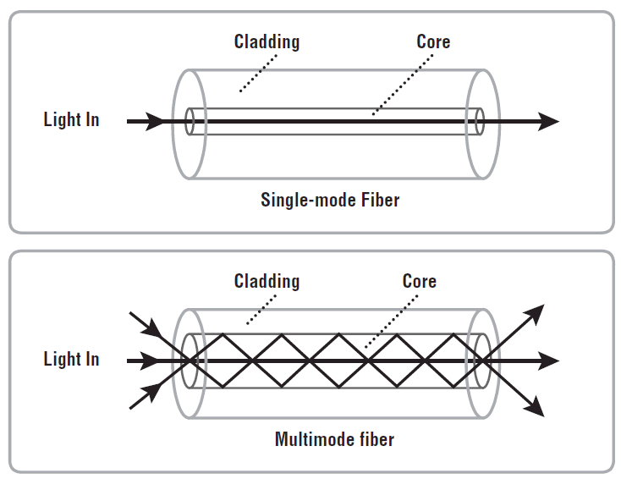
Components of SAN: Cabling
SAN implementation uses:
  Copper cables for short distance
  Optical fiber cables for long distance
Two types of optical cables
  Single-mode
    Can carry single beams of light
    Distance up to 10 KM
  Multi-mode
    Can carry multiple beams of light simultaneously
    Distance up to 500 meters
Notes:
SAN implementations use optical fiber cabling. Copper can be used for shorter distances for back-end connectivity, as it provides a better signal-to-noise ratio for distances up to 30 meters. Optical fiber cables carry data in the form of light. There are two types of optical cables, multi-mode and single-mode.
Multi-mode fiber (MMF) cable carries multiple beams of light projected at different angles simultaneously onto the core of the cable. Based on the bandwidth, multimode fibers are classified as OM1 (62.5μm), OM2 (50μm) and laser optimized OM3 (50μm). In an MMF transmission, multiple light beams traveling inside the cable tend to disperse and collide. This collision weakens the signal strength after it travels a certain distance — a process known as modal dispersion. An MMF cable is usually used for distances of up to 500 meters because of signal degradation (attenuation) due to modal dispersion.
Single-mode fiber (SMF) carries a single ray of light projected at the center of the core. These cables are available in diameters of 7–11 microns; the most common size is 9 microns. In an SMF transmission, a single light beam travels in a straight line through the core of the fiber. The small core and the single light wave limits modal dispersion. Among all types of fibre cables, single-mode provides minimum signal attenuation over maximum distance (up to 10 km). A single-mode cable is used for long- distance cable runs, limited only by the power of the laser at the transmitter and sensitivity of the receiver.

Slide 10
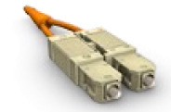
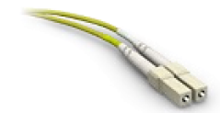
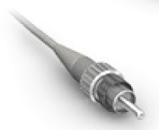
Components of SAN: Cabling (Connectors)
Node Connectors:
SC Duplex Connectors
LC Duplex Connectors
Patch panel Connectors
ST Simplex Connectors
SC Connector
LC Connector
ST Connector
Notes:
A Standard connector (SC) and a Lucent connector (LC) are two commonly used connectors for fiber optic cables. An SC is used for data transmission speeds up to 1 Gb/s, whereas an LC is used for speeds up to 4 Gb/s. A Straight Tip (ST) is a fiber optic connector with a plug and a socket that is locked with a half-twisted bayonet lock. In the early days of FC deployment, fiber optic cabling predominantly used ST connectors. This connector is often used with Fibre Channel patch panels.
The Small Form-factor Pluggable (SFP) is an optical transceiver used in optical communication. The standard SFP+ transceivers support data rates up to 10 Gb/s.

Slide 11
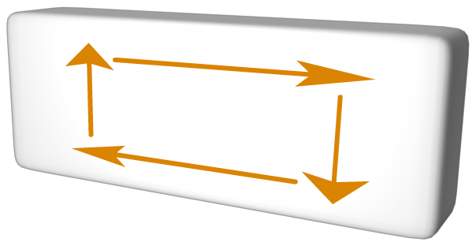
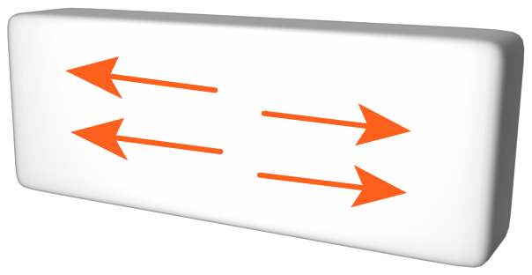
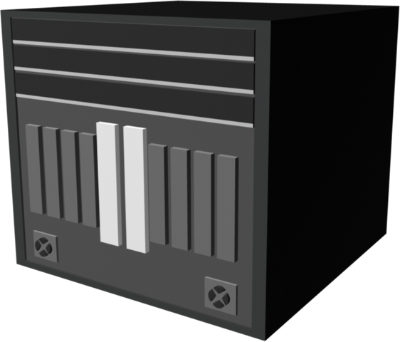
Components of SAN: Interconnecting devices
Basis for SAN communication
  Hubs
  Switches and
  Directors
FC HUB
FC Switch
Director
Notes:
Hubs, switches, and directors are the interconnect devices commonly used in SAN. Hubs are used as communication devices in FC-AL implementations. Hubs physically connect nodes in a logical loop or a physical star topology. All the nodes must share the bandwidth because data travels through all the connection points. Because of availability of low cost and high performance switches, hubs are no longer used in SANs. Switches are more intelligent than hubs and directly route data from one physical port to another. Therefore, nodes do not share the bandwidth. Instead, each node has a dedicated communication path, resulting in bandwidth aggregation.

Slide 12
Components of SAN: Storage array
Provides storage consolidation and centralization
Features of an array
  High Availability/Redundancy
  Performance
  Business Continuity
  Multiple host connect
HBA
Arrays
HBA
FC SAN
HBA
Servers
Notes:
The fundamental purpose of a SAN is to provide host access to storage resources. The large storage capacities offered by modern storage arrays have been exploited in SAN environments for storage consolidation and centralization. SAN implementations complement the standard features of storage arrays by providing high availability and redundancy, improved performance, business continuity, and multiple host connectivity.

Slide 13
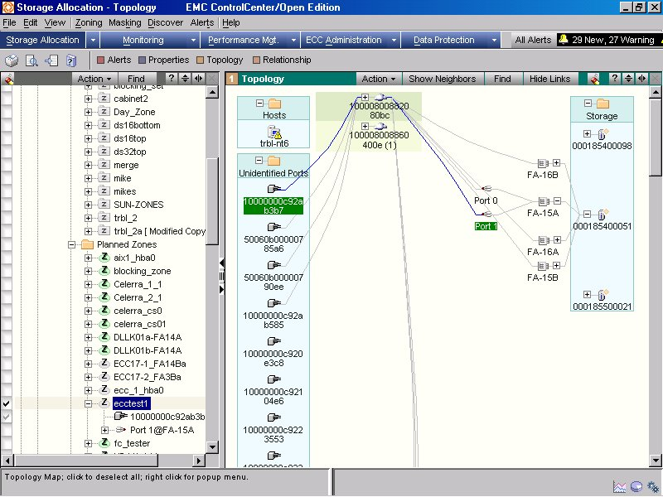
Components of SAN: SAN management software
A suite of tools used in a SAN to manage the interface between host and storage arrays
Provides integrated management of SAN environment
Web based GUI or CLI
Notes:
SAN management software manages the interfaces between hosts, interconnect devices, and storage arrays. The software provides a view of the SAN environment and enables management of various resources from one central console. It provides key management functions, including mapping of storage devices, switches, and servers, monitoring and generating alerts for discovered devices, and logical partitioning of the SAN, called zoning. In addition, the software provides management of typical SAN components such as HBAs, storage components, and interconnecting devices.

Slide 14
SAN Interconnectivity Options: Point to Point
Point to point (Pt-to-Pt)
  Direct connection between devices
  Limited connectivity
Storage Array
Servers
Notes:
The FC architecture supports three basic interconnectivity options: point-to-point, arbitrated loop (FC- AL), and fabric connect.
Point-to-point is the simplest FC configuration — two devices are connected directly to each other. This configuration provides a dedicated connection for data transmission between nodes. However, the point-to-point configuration offers limited connectivity, as only two devices can communicate with each other at a given time. Moreover, it cannot be scaled to accommodate a large number of network devices. Standard DAS uses point-to-point connectivity.

Slide 15
SAN Interconnectivity Options: FC-AL
Fibre Channel Arbitrated Loop (FC-AL)
  Devices must arbitrate to gain control
  Devices are connected via hubs
  Supports up to 127 devices
FC Hub
Storage Array
Servers
Notes:
In the FC-AL configuration, devices are attached to a shared loop. FC-AL has the characteristics of a token ring topology and a physical star topology. In FC-AL, each device contends with other devices to perform I/O operations. Devices on the loop must “arbitrate” to gain control of the loop. At any given time, only one device can perform I/O operations on the loop.
As a loop configuration, FC-AL can be implemented without any interconnecting devices by directly connecting one device to another in a ring through cables.
However, FC-AL implementations may also use hubs whereby the arbitrated loop is physically connected in a star topology. The FC-AL configuration has the following limitations in terms of scalability:
FC-AL shares the bandwidth in the loop. Only one device can perform I/O operations at a time. Because each device in a loop has to wait for its turn to process an I/O request, the speed of data transmission is low in an FC-AL topology.
FC-AL uses 8-bit addressing. It can support up to 127 devices on a loop.
Adding or removing a device results in loop re-initialization, which can cause a momentary pause in loop traffic.

Slide 16
FC-AL Transmission
Node A
Node D
NL_Port #1
HBA
Hub_Pt
Hub_Pt
NL_Port #2
HBA
NL_Port #1
HBA
Transmit
Receive
NL_Port #2
HBA
Byp
Byp
Byp
Receive
Byp
Transmit
Node B
Node C
NL_Port #4
HBA
NL_Port #3
FA
NL_Port #4
Array Port
Transmit
Receive
NL_Port #3
HBA
Byp
Byp
Byp
Receive
Byp
Transmit
Hub_Pt
Hub_Pt
Notes:
24
When a node in the FC-AL topology attempts to transmit data, the node sends an arbitration (ARB) frame to each node on the loop. If two nodes simultaneously attempt to gain control of the loop, the node with the highest priority is allowed to communicate with another node. This priority is determined on the basis of Arbitrated Loop Physical Address (AL-PA) and Loop ID. When the initiator node receives the ARB request it sent, it gains control of the loop. The initiator then transmits data to the node with which it has established a virtual connection. slide illustrates the process of data transmission in an FC-AL configuration.
Lets understand how arbitration is done in FC-AL. Consider Node A want to communicate with Node B, the steps are as follows:
High priority initiator, Node A inserts the ARB frame in the loop.
ARB frame is passed to the next node (Node D) in the loop.
Node D receives high priority ARB, therefore remains idle.
ARB is forwarded to next node (Node C) in the loop.
Node C receives high priority ARB, therefore remains idle.
ARB is forwarded to next node (Node B) in the loop.
Node B receives high priority ARB, therefore remains idle and
ARB is forwarded to next node (Node A) in the loop.
Node A receives ARB back; now it gains control of the loop and can start communicating with target Node B.

Slide 17
SAN Interconnectivity Options: FC-SW
Fibre Channel Switched Fabric connect (FC-SW)
  Dedicated bandwidth between devices
  Support up to 15 million devices
  Higher availability than hubs
Storage Array
Servers
Notes:
Unlike a loop configuration, a Fibre Channel switched fabric (FC-SW) network provides interconnected devices, dedicated bandwidth, and scalability. The addition or removal of a device in a switched fabric is minimally disruptive; it does not affect the ongoing traffic between other devices. FC-SW is also referred to as fabric connect. A fabric is a logical space in which all nodes communicate with one another in a network. This virtual space can be created with a switch or a network of switches. Each switch in a fabric contains a unique domain identifier, which is part of the fabric’s addressing scheme. In FC-SW, nodes do not share a loop; instead, data is transferred through a dedicated path between the nodes. Each port in a fabric has a unique 24-bit fibre channel address for communication.

Slide 18
FC-SW Transmission
Node A
Node D
NL_Port #1
HBA
Port
Port
NL_Port #2
HBA
N_Port #1
HBA
Transmit
Receive
N_Port #2
Storage Port
Receive
Transmit
Node B
Node C
NL_Port #4
HBA
Transmit
Receive
N_Port #3
Storage Port
N_Port #4
HBA
Receive
Port
Port
Transmit
Notes:
FC-SW uses switches that are intelligent devices. They can switch data traffic from an initiator node to a target node directly through switch ports. Frames are routed between source and destination by the fabric. As shown in slide, if node B wants to communicate with node D, Nodes should individually login first and then transmit data via the FC-SW. This link is considered a dedicated connection between the initiator and the target.

Slide 19
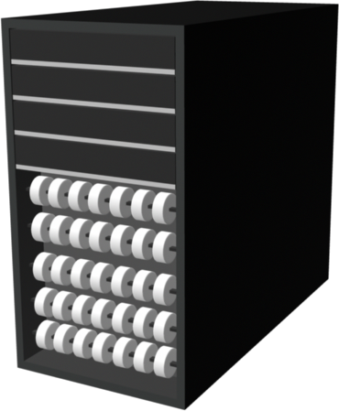
Port Types
Host
?
?
NL-Port
NL-Port
Tape Library
?
FC Hub
Host
NL-Port
Host
?
N-Port
F-Port
FC Switch
?
?
FL-Port
FC Switch
?
?
?
?
F-Port
E-Port
E-Port
F-Port
?
?
N-Port
N-Port
Storage Array
Storage Array
Notes:
Ports are the basic building blocks of an FC network. Ports on the switch can be one of the following types:
N_port: An end point in the fabric. This port is also known as the node port. Typically, it is a host port (HBA) or a storage array port that is connected to a switch in a switched fabric.
NL_port: A node port that supports the arbitrated loop topology. This port is also known as the node loop port.
E_port: An FC port that forms the connection between two FC switches. This port is also known as the expansion port. The E_port on an FC switch connects to the E_port of another FC switch in the fabric through a link, which is called an InterSwitch Link (ISL). ISLs are used to transfer host-tostorage data as well as the fabric management traffic from one switch to another. ISL is also one of the scaling mechanisms in SAN connectivity.
F_port: A port on a switch that connects an N_port. It is also known as a fabric port and cannot participate in FC-AL.
FL_port: A fabric port that participates in FC-AL. This port is connected to the NL_ports on an FC-AL loop. A FL_port also connects a loop to a switch in a switched fabric. As a result, all NL_ports in the loop can participate in FC-SW. This configuration is referred to as a public loop. In contrast, an arbitrated loop without any switches is referred to as a private loop. A private loop contains nodes with NL_ports, and does not contain FL_port.
G_port: A generic port that can operate as an E_port or an F_port and determines its functionality automatically during initialization.
Slide shows various FC ports located in the fabric.

Slide 20
Inter Switch Links (ISL)
ISL connects two or more FC switches to each other using E-Ports
ISLs are used to transfer host-to-storage data as well as the fabric management traffic from one switch to another
ISL is also one of the scaling mechanisms in SAN connectivity
Multimode Fiber
1Gb=500m 2Gb=300m
FC Switch
FC Switch
Single-mode Fiber
up to10 km
FC Switch
FC Switch
Notes:
An ISL (Inter-Switch Link) allows for two or more Fibre Channel switches to be connected together to form a single, but larger, fabric. Expansion ports (E_Ports) on an FC switch provide interswitch link (ISL) connectivity to fabric directors and switches.
ISLs are used to transfer host-to-storage data as well as the fabric management traffic from one switch to another. ISL is also one of the scaling mechanisms in SAN connectivity.
By using inter-switch links, a switched fabric can be expanded to connect hundreds of nodes.

Slide 21
Login Types in a Switched Network
Extended Link Services that are defined in the standards:
FLOGI - Fabric login
  Between N_Port to F_Port
PLOGI - Port login
  Between N_Port to N_Port
  N_Port establishes a session with another N_Port
PRLI - Process login
  Between N_Port to N_Port
  To share information about the upper layer protocol type in use
  And recognizing device as the SCSI initiator, or target
Notes:
Fabric services define three login types:
Fabric login (FLOGI) is performed between an N_port and an F_port. To log on to the fabric, a device sends a FLOGI frame with the World Wide Node Name (WWNN) and World Wide Port Name (WWPN) parameters to the login service at the well-known FC address FFFFFE. In turn, the switch accepts the login and returns an Accept (ACC) frame with the assigned FC address for the device. Immediately after the FLOGI, the N_port registers itself with the local name server on the switch, indicating its WWNN, WWPN, and assigned FC address.
Port login (PLOGI) is performed between an N_port and another N_port to establish a session. The initiator N_port sends a PLOGI request frame to the target N_port, which accepts it. The target N_port returns an ACC to the initiator N_port. Next, the N_ports exchange service parameters relevant to the session.
Process login (PRLI) is also performed between an N_port and another N_ port. This login relates to the FC upper layer protocols (ULP) such as SCSI. N_ports exchange SCSI-3-related service parameters. N_ports share information about the ULP type in use, the SCSI initiator, or the target.

Slide 22
Lesson Summary
Key topics covered in this lesson:
FC SAN and its components
SAN Interconnectivity Options
Port types and inter switch links

Slide 23
Lesson: Fibre Channel Architecture
Upon completion of this lesson, you will be able to:
Describe layers of FC
Describe FC protocol stack
Discuss FC addressing
Define WWN addressing
Discuss structure and organization of FC Data

Slide 24
FC Architecture Overview
FC uses channel technology
Provide high performance with low protocol overheads
FCP is SCSI-3 over FC network
  Sustained transmission bandwidth over long distances
  Provides speeds up to 8 Gb/s (8 GFC)
FCP has five layers:
  FC-4
  FC-2
  FC-1
  FC-0
  *FC-3 is not yet implemented
Application
FC-4
SCSI
HIPPI
ESCON
ATM
IP
FC-2
Framing/Flow Control
FC-1
Encode/Decode
FC-0
1 Gb/s
2 Gb/s
4 Gb/s
8 Gb/s
Notes:
The FC architecture represents true channel/network integration with standard interconnecting devices. Connections in a SAN are accomplished using FC. Traditionally, transmissions from host to storage devices are carried out over channel connections such as a parallel bus. Channel technologies provide high levels of performance with low protocol overheads. Such performance is due to the static nature of channels and the high level of hardware and software integration provided by the channel technologies. However, these technologies suffer from inherent limitations in terms of the number of devices that can be connected and the distance between these devices. Fibre Channel Protocol (FCP) is the implementation of serial SCSI-3 over an FC network. In the FCP architecture, all external and remote storage devices attached to the SAN appear as local devices to the host operating system. The key advantages of FCP are as follows:
Sustained transmission bandwidth over long distances.
Support for a larger number of addressable devices over a network.
Exhibits the characteristics of channel transport and provides speeds up to 8 Gb/s (8 GFC).

Slide 25
Fibre Channel Protocol Stack
FC layer | Function | SAN relevant features specified by FC layer
FC-4 | Mapping interface | Mapping upper layer protocol (e.g. SCSI-3 to FC transport
FC-3 | Common services | Not implemented
FC-2 | Routing, flow control | Frame structure, ports, FC addressing, buffer credits
FC-1 | Encode/decode | 8b/10b encoding, bit and frame synchronization
FC-0 | Physical layer | Media, cables, connector
Notes:
FCP defines the communication protocol in five layers: FC-0 through FC-4 (except FC-3 layer, which is not implemented). In a layered communication model, the peer layers on each node talk to each other through defined protocols.
FC-4 Upper Layer Protocol:
FC-4 is the uppermost layer in the FCP stack. This layer defines the application interfaces and the way Upper Layer Protocols (ULPs) are mapped to the lower FC layers. The FC standard defines several protocols that can operate on the FC-4 layer. Some of the protocols include SCSI, HIPPI Framing Protocol, Enterprise Storage Connectivity (ESCON), ATM, and IP.
FC-2 Transport Layer:
The FC-2 is the transport layer that contains the payload, addresses of the source and destination ports, and link control information. The FC-2 layer provides Fibre Channel addressing, structure, and organization of data (frames, sequences, and exchanges). It also defines fabric services, classes of service, flow control, and routing.
FC-1 Transmission Protocol:
This layer defines the transmission protocol that includes serial encoding and decoding rules, special characters used, and error control. At the transmitter node, an 8-bit character is encoded into a 10-bit transmissions character. This character is then transmitted to the receiver node. At the receiver node, the 10-bit character is passed to the FC-1 layer, which decodes the 10-bit character into the original 8-bit character.
FC-0 Physical Interface:
FC-0 is the lowest layer in the FCP stack. This layer defines the physical interface, media, and transmission of raw bits. The FC-0 specification includes cables, connectors, and optical and electrical parameters for a variety of data rates. The FC transmission can use both electrical and optical media.

Slide 26
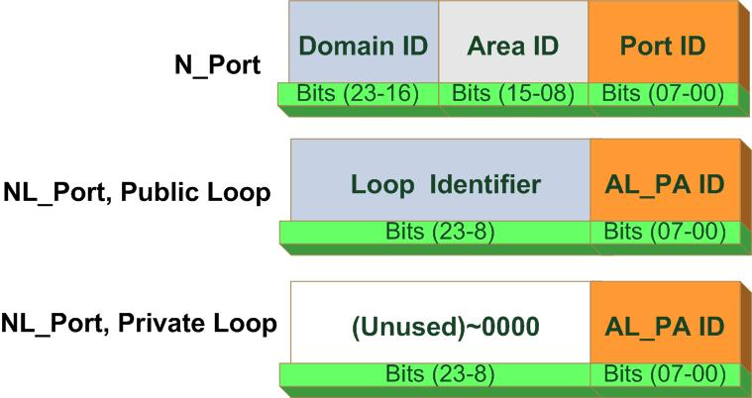
Fibre Channel Addressing
FC Address is assigned during Fabric Login
  Used to communicate between nodes within SAN
  Similar in functionality to an IP address on NICs
Address Format:
  24 bit address, dynamically assigned
  Contents of the three bytes depend on the type of N-Port
  For an N_Port or a public NL_Port:
    switch maintains mapping of WWN to FC-Address via the Name Server
Notes:
Fibre Channel Address is dynamically assigned during fabric login. It has a distinct format depending on the type of node port as shown in the diagram.
The address format depends upon the type of node in the fabric: N_Port, NL_Port in a Public Loop, or NL_Port in a private loop.
FC Address of an N_Port:
The first field contains the domain ID of the switch (the domain ID is discussed in more detail in the next lesson). Although this is an 8-bit field, there are only 239 available addresses for domain ID, since some addresses are deemed special and reserved for fabric management services. The area ID is used to identify a group of F_Ports. An example of a group of F_Ports would be a card on the switch with more than one port on it. The last field identifies the F_Port within the group.
The maximum possible number of N_Ports in a switched fabric is thus:
(239 domains X 256 areas X 256 ports) = 15,663,104 Fibre Channel addresses.
FC Address of an NL_Port:
If no switch connection exists to an arbitrated loop, all NL_Ports are in a private loop and the two upper bytes of their FC addresses are zeroes.
If the loop is attached to a fabric and an NL_Port supports a fabric login, the two upper bytes are assigned a positive value – called the loop identifier - by the switch. We call this mode a public loop. The loop identifier is the same for all NL_Ports on a given loop.
In public and private arbitrated loops, the last byte of the 24-bit port address refers to the arbitrated loop physical address (AL_PA). There are 127 allowable AL_PA addresses within a loop. In a fabric-attached or public loop there may be no more than 126 NL_Ports, with one address reserved for the FL_Port on the switch.

Slide 27
World Wide Names
Unique 64 bit identifier
Static to the port
  Used to physically identify ports or nodes within SAN
  Similar to NIC’s MAC address
World Wide Name - Array
5
0
0
6
0
1
6
0
0
0
6
0
0
1
B
2
0101
0000
0000
0110
0000
0001
0110
0000
0000
0000
0110
0000
0000
0001
1011
0010
Company ID
Port
Model Seed
24 bits
32 bits
World Wide Name - HBA
1
0
0
0
0
0
0
0
c
9
2
0
d
c
4
0
Reserved
Company ID
Company Specific
12 bits
24 bits
24 bits
Notes:
Each device in the FC environment is assigned a 64-bit unique identifier called the World Wide Name (WWN). The Fibre Channel environment uses two types of WWNs: World Wide Node Name (WWNN) and World Wide Port Name (WWPN). Unlike an FC address, which is assigned dynamically, a WWN is a static name for each device on an FC network. WWNs are similar to the Media Access Control (MAC) addresses used in IP networking. WWNs are burned into the hardware or assigned through software. Several configuration definitions in a SAN use WWN for identifying storage devices and HBAs. The name server in an FC environment keeps the association of WWNs to the dynamically created FC addresses for nodes. Figure illustrates the WWN structure for an array and the HBA.

Slide 28
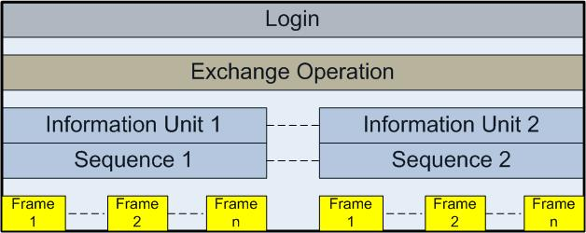
Structure and Organization of FC Data
FC data is organized as:
  Exchange operations
    Enables two N_ports to identify and manage a set of information units
    Maps to sequence
  Sequence
    Contiguous set of frames sent from one port to another
  Frames
    Fundamental unit of data transfer
    Each frame can contain up to 2112 bytes of payload
SOF
Frame Header
Data Field
CRC
EOF
4 Bytes
24 Bytes
0 - 2112 Bytes
4 Bytes
4 Bytes
Notes:
In an FC network, data transport is analogous to a conversation between two people, whereby a frame represents a word, a sequence represents a sentence, and an exchange represents a conversation.
Exchange operation: An exchange operation enables two N_ports to identify and manage a set of information units. This unit maps to a sequence. Sequences can be both unidirectional and bidirectional depending upon the type of data sequence exchanged between the initiator and the target.
Sequence: A sequence refers to a contiguous set of frames that are sent from one port to another. A sequence corresponds to an information unit, as defined by the ULP.
Frame: A frame is the fundamental unit of data transfer at Layer 2. Each frame can contain up to 2,112 bytes of payload.

Slide 29
Lesson Summary
Key topics covered in this lesson:
Fibre Channel Protocol Stack
Fibre Channel Addressing
Data Organization: Frame, Sequence and Exchange

Slide 30
Lesson: FC Topologies and Management
Upon completion of this lesson, you will be able to:
Define FC fabric topologies
Describe different types of zoning

Slide 31
Fabric Topology: Core-Edge Fabric
Can be two or three tiers
  Single Core Tier
  One or two Edge Tiers
In a two tier topology, storage is usually connected to the Core
Benefits
  High Availability
  Medium Scalability
  Medium to maximum Connectivity
Edge Tier
FC Switch
FC Switch
FC Switch
Server
Core Tier
Director
Single-core topology
Storage Array
Edge Tier
FC Switch
FC Switch
FC Switch
Director
Director
Server
Core Tier
Dual-core topology
Storage Array
Notes:
A fabric topology can be described by the number of tiers it contains. The number of tiers in a fabric is based on the number of switches traversed between two points that are farthest from each other. However, note that this number is based on the infrastructure constructed by the fabric topology; it disregards how the storage and server are connected across the switches.
In the core-edge fabric topology, there are two types of switch tiers in this fabric. The edge tier usually comprises switches and offers an inexpensive approach to adding more hosts in a fabric. The core tier usually comprises enterprise directors that ensure high fabric availability. Additionally all traffic has to either traverse through or terminate at this tier. In a two-tier configuration, all storage devices are connected to the core tier. The host-to-storage traffic has to traverse one and two ISLs in a two-tier and three-tier configuration, respectively. Hosts used for mission-critical applications can be connected directly to the core tier and consequently avoid traveling through the ISLs to process I/O requests from these hosts.
The core-edge fabric topology increases connectivity within the SAN while conserving overall port utilization. If expansion is required, an additional edge switch can be connected to the core. This topology can have different variations.
In a single-core topology, all hosts are connected to the edge tier and all storage is connected to the core tier. A dual-core topology can be expanded to include more core switches. However, to maintain the topology, it is essential that new ISLs are created to connect each edge switch to the new core switch that is added.

Slide 32
Faric Topology: Mesh
Can be either partial or full mesh
All switches are connected to each other
Host and Storage can be located anywhere in the fabric
Host and Storage can be localized to a single switch
FC Switches
FC Switches
Server
Partial Mesh
Server
Full Mesh
Storage Array
Storage Array
Notes:
In a mesh topology, each switch is directly connected to other switches by using ISLs. This topology promotes enhanced connectivity within the SAN. When the number of ports on a network increases, the number of nodes that can participate and communicate also increases. A mesh topology may be one of the two types: full mesh or partial mesh. In a full mesh, every switch is connected to every other switch in the topology. Full mesh topology may be appropriate when the number of switches involved is small. A typical deployment would involve up to four switches or directors, with each of them servicing highly localized host-to-storage traffic. In a full mesh topology, a maximum of one ISL or hop is required for host-to-storage traffic.
In a partial mesh topology, several hops or ISLs may be required for the traffic to reach its destination. Hosts and storage can be located anywhere in the fabric, and storage can be localized to a director or a switch in both mesh topologies. A full mesh topology with a symmetric design results in an even number of switches, whereas a partial mesh has an asymmetric design and may result in an odd number of switches.

Slide 33
Fabric Management: Zoning
FC SAN
Storage Array
Array port
HBA
Servers
Notes:
Zoning is an FC switch function that enables nodes within the fabric to be logically segmented into groups that can communicate with each other. When a device (host or storage array) logs onto a fabric, it is registered with the name server. When a port logs onto the fabric, it goes through a device discovery process with other devices registered in the name server. The zoning function controls this process by allowing only the members in the same zone to establish these link-level services.

Slide 34
Zoning Components
Zone sets
Zone set
(Library)
Zone
(Library)
Zone
Zone
Zone
Member
WWN's
Member
Member
Member
Member
Member
Member
Notes:
Multiple zone sets may be defined in a fabric, but only one zone set can be active at a time. A zone set is a set of zones and a zone is a set of members. A member may be in multiple zones. Members, zones, and zone sets form the hierarchy defined in the zoning process. Members are nodes within the SAN that can be included in a zone. Zones comprise a set of members that have access to one another. A port or a node can be a member of multiple zones. Zone sets comprise a group of zones that can be activated or deactivated as a single entity in a fabric. Only one zone set per fabric can be active at a time. Zone sets are also referred to as zone configurations.

Slide 35
Types of Zoning
Servers
Switch Domain ID = 15
Port 5
Port 7
Zone 2
Port 1
Storage Array
WWN 10:00:00:00:C9:20:DC:40
FC Switch
Zone 3
Port 9
Port 12
WWN 10:00:00:00:C9:20:DC:56
WWN 50:06:04:82:E8:91:2B:9E
Zone 1
Zone 1 (WWN Zone) = 10:00:00:00:C9:20:DC:82 ; 50:06:04:82:E8:91:2B:9E
Zone 2 (Port Zone) = 15,5 ; 15,7
WWN 10:00:00:00:C9:20:DC:82
Zone 3 (Mixed Zone) = 10:00:00:00:C9:20:DC:56 ; 15,12
Notes:
Zoning can be categorized into three types:
Port zoning: It uses the FC addresses of the physical ports to define zones. In port zoning, access to data is determined by the physical switch port to which a node is connected. The FC address is dynamically assigned when the port logs on to the fabric. Therefore, any change in the fabric configuration affects zoning. Port zoning is also called hard zoning. Although this method is secure, it requires updating of zoning configuration information in the event of fabric reconfiguration.
WWN zoning: It uses World Wide Names to define zones. WWN zoning is also referred to as soft zoning. A major advantage of WWN zoning is its flexibility. It allows the SAN to be re-cabled without reconfiguring the zone information. This is possible because the WWN is static to the node port.
Mixed zoning: It combines the qualities of both WWN zoning and port zoning. Using mixed zoning enables a specific port to be tied to the WWN of a node.
Zoning is used in conjunction with LUN masking for controlling server access to storage. However, these are two different activities. Zoning takes place at the fabric level and LUN masking is done at the array level.

Slide 36
Lesson Summary
Key topics covered in this lesson:
FC SAN Topologies
  Core-Edge
  Mesh
Fabric management by zoning

Slide 37
Module Summary
Key topics covered in this module:
SAN features and benefits
SAN connectivity options
Port types and inter switch links
FC protocol stack and addressing
FC fabric topologies
Fabric management by zoning

Slide 38
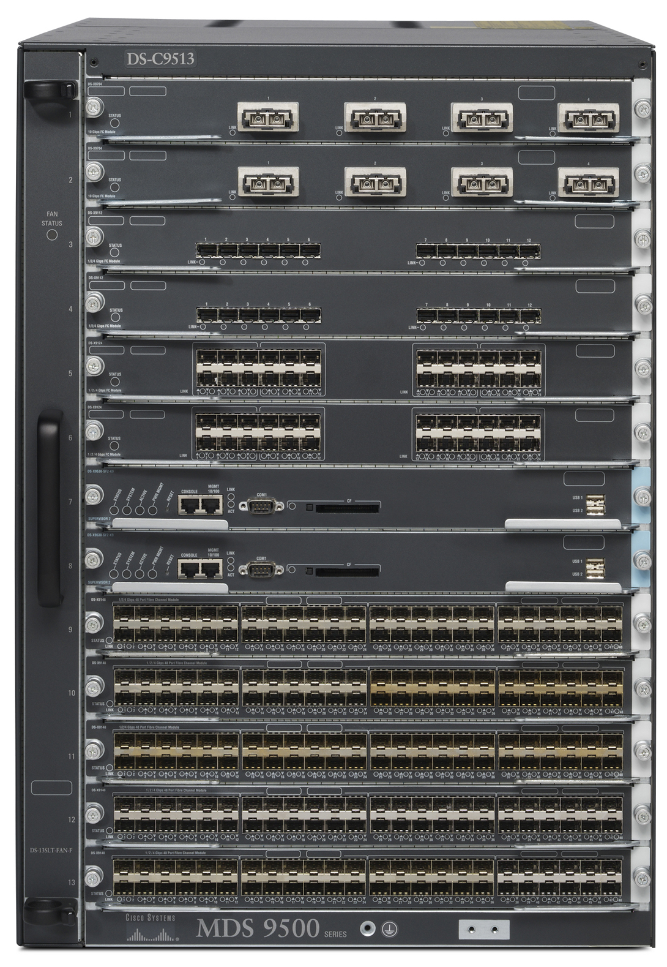
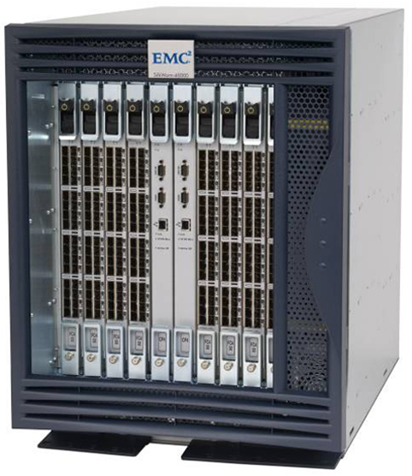
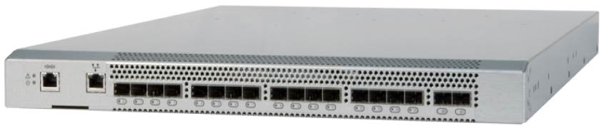
Concept in Practice – EMC Connectrix
Connectrix family consist of
  Enterprise directors
  Departmental switches
  Multi-protocol routers
MDS-9513 Director
MP-7500B
ED-48000B Director
Notes:
FC switches and directors are key components of the SAN environment. EMC offers Enterprise directors, Departmental switches, and Multi-protocol routers connectivity products under the Connectrix brand.
Enterprise directors are ideal for large enterprise connectivity. They offer high port density and high component redundancy. Enterprise directors are deployed in high-availability or large-scale environments. Connectrix directors offer several hundred ports per domain. Departmental switches are best suited for workgroup, mid-tier environments. Multi-protocol routers support mixed iSCSI and FC environments. They can bridge FC SAN and IP SAN, a feature that enables these routers to provide connectivity between iSCSI host initiators and FC storage targets. They can extend FC SAN over long distances through IP networks. In addition to FC ports, Connectrix switches and directors have Ethernet ports and serial ports for communication and switch management functions. Connectrix management software enables configuration, monitoring, and management of Connectrix switches.
EMC ControlCenter SAN Manager provides a single interface for managing SAN. With SAN Manager one can discover, monitor, manage, and configure complex heterogeneous SAN environments faster and easier. It streamlines and centralizes SAN management operations across multi-vendor storage networks and storage devices.

Slide 39
Review Questions
✓
Name three key features of a SAN implementation.
What is a fabric?
Describe how a SAN can be connected?
What is a purpose of ISL
What is a function of layer-2 in FC architecture
Define the purpose of zoning?
What is a Core-Edge Fabric?

